Slide 1
Docker containers hands-on
Course 3563
Oded Nissan - oded@midlink.co.il

Slide 2
Agenda
Introduction to Docker
Docker Architecture
Docker Basics
The Dockerfile Creating images
The DockerHub and private registries
Docker networking
Logging and monitoring
Docker testing
Docker deployment

Slide 3
Introduction to docker

Slide 4
Why Docker ?

Slide 5

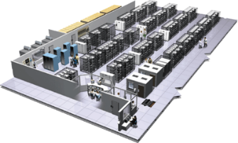

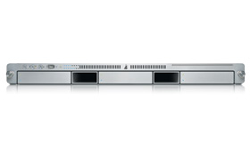
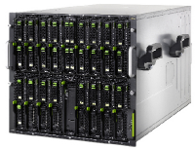

The Challenge
User DB
Static website
postgresql + pgv8 + v8
Queue
Analytics DB
nginx 1.5 + modsecurity + openssl + bootstrap 2
Do services and apps interact appropriately?
Redis + redis-sentinel
hadoop + hive + thrift + OpenJDK
Multiplicity of Stacks
Background workers
Web frontend
Python 3.0 + celery + pyredis + libcurl + ffmpeg + libopencv + nodejs + phantomjs
Ruby + Rails + sass + Unicorn
API endpoint
Python 2.7 + Flask + pyredis + celery + psycopg + postgresql-client
Production Cluster
Development VM
Public Cloud
Multiplicity of hardware environments
QA server
Can I migrate smoothly and quickly?
Disaster recovery
Customer Data Center
Contributor’s laptop
Production Servers

Slide 6
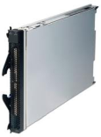
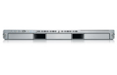
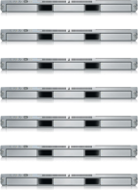

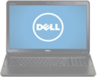
Results in N X N compatibility nightmare
? | ? | ? | ? | ? | ? | ?
? | ? | ? | ? | ? | ? | ?
? | ? | ? | ? | ? | ? | ?
? | ? | ? | ? | ? | ? | ?
? | ? | ? | ? | ? | ? | ?
? | ? | ? | ? | ? | ? | ?
Static website
Web frontend
Background workers
User DB
Analytics DB
Queue
 | Development VM | QA Server | Single Prod Server | Onsite Cluster | Public Cloud | Contributor’s laptop | Customer Servers

Slide 7
The shipping analogy

Slide 8

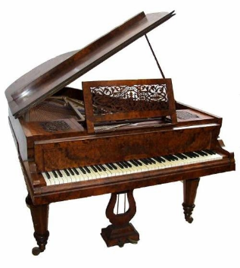

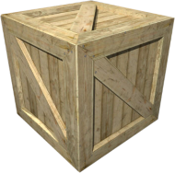
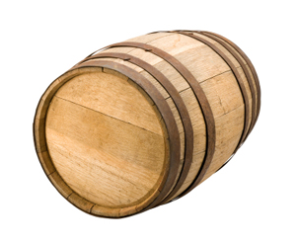
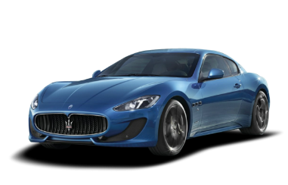
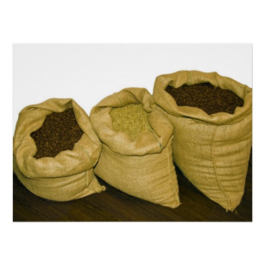



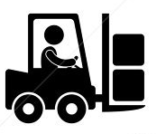
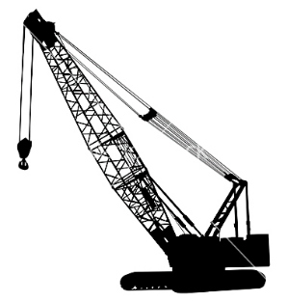
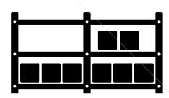

Cargo Transport Pre-1960
Do I worry about how goods interact (e.g. coffee beans next to spices)
Multiplicity of Goods
Multipilicity of methods for transporting/storing
Can I transport quickly and smoothly
(e.g. from boat to train to truck)

Slide 9


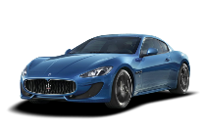


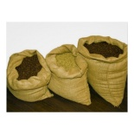


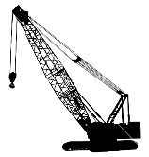



Also an NxN Matrix
 | ? | ? | ? | ? | ? | ? | ?
 | ? | ? | ? | ? | ? | ? | ?
 | ? | ? | ? | ? | ? | ? | ?
 | ? | ? | ? | ? | ? | ? | ?
 | ? | ? | ? | ? | ? | ? | ?
 | ? | ? | ? | ? | ? | ? | ?

Slide 10

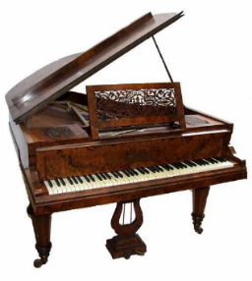

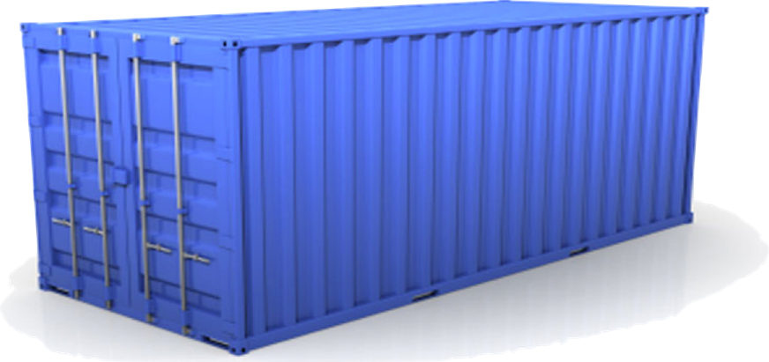
Solution: Intermodal Shipping Container
Do I worry about how goods interact (e.g. coffee beans next to spices)
Multiplicity of Goods
A standard container that is loaded with virtually any goods, and stays sealed until it reaches final delivery.
…in between, can be loaded and unloaded, stacked, transported efficiently over long distances, and transferred from one mode of transport to another
Can I transport quickly and smoothly
(e.g. from boat to train to truck)
Multiplicity of methods for transporting/storing

Slide 11
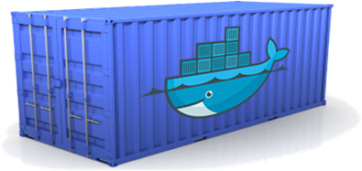
Docker is a shipping container for code
Static website
User DB
Web frontend
Queue
Analytics DB
Do services and apps interact appropriately?
Multiplicity of Stacks
An engine that enables any payload to be encapsulated as a lightweight, portable, self-sufficient container…
…that can be manipulated using standard operations and run consistently on virtually any hardware platform
Multiplicity of hardware environments
Can I migrate smoothly and quickly
Development VM
QA server
Customer Data Center
Public Cloud
Production Cluster
Contributor’s laptop

Slide 12
What is a container ?
Containers include the application and all of its dependencies, but share the kernel with other containers.
They run as an isolated process in userspace on the host operating system.
They’re also not tied to any specific infrastructure – Docker containers run on any computer, on any infrastructure and in any cloud.
Each container has its own file system.

Slide 13
Containers vs. VMs
App
A
App
A’
App
B
Containers are isolated,
but share OS and, where
appropriate, bins/libraries
Bins/
Libs
Bins/
Libs
Bins/
Libs
…result is significantly faster deployment, much less overhead, easier migration, faster restart
VM
Guest
OS
Guest
OS
Guest
OS
Guest
OS
Guest
OS
App A
App A’
App B
App B’
App B’
App B’
Container
Docker
Hypervisor (Type 2)
Bins/Libs
Bins/Libs
Host OS
Host OS
Server
Server

Slide 14
Why are Docker containers lightweight?
Containers
App
A
App
A
App
A’
App
A
App
A
App Δ
Bins/
Libs
Bins/
Libs
Bins/
Libs
Bins/
Libs
Bins/
Guest
OS
Guest
OS
Guest
OS
Guest
OS
Original App
(No OS to take
up space, resources,
or require restart)
Copy of
App
No OS. Can
Share bins/libs
Modified App
Union file system allows
us to only save the diffs
Between container A and container
A’
VMs
Every app, every copy of an
app, and every slight modification
of the app requires a new virtual server

Slide 15
Docker History
For decades, UNIX systems have had the chroot command that provides a simple form of filesystem isolation.
Google started the development of CGroups for the Linux kernel and began moving its infrastructure to containers.
The Linux Containers (LXC) project started in 2008 and brought together CGroups, kernel namespaces, and chroot technology.
Finally, in 2013, Docker brought the final pieces to the containerization puzzle, and the technology began to enter the mainstream.

Slide 16
summary
Why Docker ?
The Shipping Analogy
What is a container.

Slide 17
Questions ?

Slide 18
Docker Architecture

Slide 19
Docker architecture
Docker uses a client-server architecture.
The Docker client talks to the Docker daemon, which does the heavy lifting of building, running, and distributing your Docker containers.
Both the Docker client and the daemon can run on the same system, or you can connect a Docker client to a remote Docker daemon.
The Docker client and daemon communicate via sockets or through a RESTful API.

Slide 20
Docker Components
Docker daemon
Docker client
Docker registry
Docker image
Docker container

Slide 21
Docker Daemon
the Docker daemon runs on a host machine. The user does not directly interact with the daemon, but instead through the Docker client.

Slide 22
Docker client
The Docker client is the primary user interface to Docker.
It accepts commands from the user and communicates back and forth with a Docker daemon.
Contains the Docker binary CLI
Talks to the Docker daemon using HTTP.

Slide 23
Docker registry
Docker registries store and distribute images.
The default registry is the Docker Hub, which hosts thousands of public images as well as curated “official” images.
Many organizations run their own registries that can be used to store commercial or sensitive images as well as avoiding the overhead of needing to download images from the Internet.

Slide 24
Docker image
A Docker image is a read-only template.
The image contains preinstalled components.
Images are used to create Docker containers.
Docker provides a simple way to build new images or update existing images,
You can download Docker images that other people have already created.

Slide 25
Docker container
A Docker container is an instance of an image.
A Docker container holds everything that is needed for an application to run.
Docker containers can be run, started, stopped, moved, and deleted.
Each container is an isolated and secure application platform.

Slide 26
Docker architecture

Slide 27
Changes and Updates
Docker
Container
Image Registry
App
A
Push
App Δ
Bins/
Libs
Bins/
Base
Container
Image
Container Mod A’
Container Mod A’’
App Δ
Update
App
A
Bins/
App
A’’
Bins/
Libs
Bins/
Libs
Bins/
Docker Engine
Docker Engine
Host is now running A’’
Host running A wants to upgrade to A’’. Requests update. Gets only diffs

Slide 28
Questions ?

Slide 29
Docker Basics

Slide 30
Installing dockeR
Exercise
Running docker commands using the exercises.

Slide 31
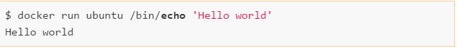
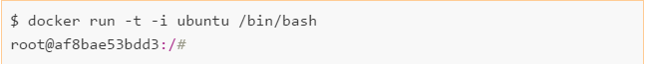
Run a container
Run a container interactively:

Slide 32
Docker commands
For each docker command we can get a CLI help by typing:
$docker <command> --help
The docker run reference -https://docs.docker.com/engine/reference/run/
Docker command reference - https://docs.docker.com/engine/reference/commandline/cli/

Slide 33
Docker run
-a, --attach - Attaches the given stream (STDOUT, etc.) to the terminal. If unspecified and the container is started in interactive mode (-i), stdin is also attached.Incompatible with –d
-d, --detach - Runs the container in “detached” mode. The command will run the container in the background and return the container ID.
-i, --interactive Keeps stdin open (even when it’s not attached). Generally used with -t to start an interactive container session. For example: $ docker run -it debian /bin/bash root@bd0f26f928bb:/# ls

Slide 34
Docker run
-rm -Automatically removes the container when it exits. Cannot be used with -d.
-t, --tty -Allocates a pseudo-TTY. Normally used with -i to start an interactive container.
-h, --hostname - Sets the container’s unix host name to NAME. For example: $ docker run -h "myhost" debian hostname
--name NAME - Assigns the name NAME to the container. The name can then be used to address the container in other Docker commands.

Slide 35
Managing containers
docker attach [OPTIONS] CONTAINER The attach command allows the user to view or interact with the main process inside the container. For example: $ ID=$(docker run -d debian sh -c "while true; do echo 'tick'; sleep 1; done;") $ docker attach $ID
docker create Creates a container from an image but does not start it. Takes most of the same arguments as docker run. To start the container, use docker start.
docker cp Copies files and directories between a container and the host.

Slide 36
Managing containers
docker exec
Runs a command inside a container. Can be used to perform maintenance tasks or as a replacement for ssh to log in to a container. For example:
$ ID=$(docker run -d debian sh -c "while true; do sleep 1; done;")
$ docker exec $ID echo "Hello"
Hello
$ docker exec -it $ID /bin/bash
root@5c6c32041d68:/# ls

Slide 37
Managing containers
docker kill Sends a signal to the main process (PID 1) in a container.
docker pause Suspends all processes inside the given container. The processes do not receive any signal that they are being suspended and consequently cannot shut down or clean up. The processes can be restarted with docker unpause.
docker restart Restarts one or more containers. Roughly equivalent to calling docker stop followed by docker start on the containers.

Slide 38
Managing containers
docker rm Removes one or more containers. Returns the names or IDs of successfully deleted containers. By default, docker rm will not remove any volumes.
For example, to delete all stopped containers: $ docker rm $(docker ps -aq) b7a4e94253b3 e33da73c275b f47074b60757
docker start Starts a stopped container

Slide 39
Managing containers
docker stop Stops (but does not remove) one or more containers. After calling docker stop on a container, it will transition to the “exited” state.
docker unpause Restarts a container previously paused with docker pause.
docker info Prints various information on the Docker system and host. docker help Prints usage and help information for the given subcommand. Identical to running a command with the --help flag.
docker version Prints Docker version information for client and server.

Slide 40
Managing containers
docker diff Shows changes made to the containers filesystem compared to the image it was launched from. For example: $ ID=$(docker run -d debian touch /NEW-FILE) $ docker diff $ID A /NEW-FILE
docker events Prints real-time events from the daemon. Use CTRL-C to quit
docker inspect Provides detailed information on given containers or images.

Slide 41
Managing containers
docker logs Outputs the “logs” for a container. This is simply everything that has been written to STDERR or STDOUT inside the container.
docker port Lists the exposed port mappings for the given container. Can optionally be given the internal container port and protocol to look up.
For example: $ ID=$(docker run -P -d redis) $ docker port $ID 6379/tcp -> 0.0.0.0:32768

Slide 42
Managing containers
docker ps Provides high-level information on current containers, such as the name, ID, and status. Takes a lot of different arguments, notably -a for getting all containers,not just running ones. Also note the -q argument, which only returns the container IDs and is very useful as input to other commands such as docker rm.
docker top Provides information on the running processes inside a given container. In effect,this command runs the UNIX ps utility on the host and filters for processes in the given container.

Slide 43
Managing docker images
docker build Builds an image from a Dockerfile. (See next topic)
docker commit Creates an image from the specified container. While docker commit can be useful, it is generally preferable to create images using docker build, which is easily repeatable. For example: $ ID=$(docker run -d redis touch /new-file) $ docker commit -a "Joe Bloggs" -m "Comment" $ID commit:test ac479108b0fa9a02a7fb290a22dacd5e20c867ec512d6813ed42e3517711a0cf

Slide 44
Managing docker images
docker export Exports the contents of the container’s filesystem as a tar archive on STDOUT. The resulting archive can be loaded with docker import.
docker import Creates an image from an archive file containing a filesystem, such as that created by docker export.
docker history Outputs information on each of the layers in an image.

Slide 45
Managing docker images
docker images Provides a list of local images, including information such as repository name,tag name, and size.
docker load Loads a repository from a tar archive passed via STDIN. The repository may contain several images and tags. Unlike docker import, the images will include history and metadata.
docker rmi Deletes the given image or images. Images are specified by ID or repository and tag name.

Slide 46
Managing docker images
docker save Saves the named images or repositories to a tar archive, which is streamed to STDOUT (use -o to write to a file).
docker tag Associates a repository and tag name with an image. The image can identified by ID or repository and tag (the latest tag is assumed if none is given). If no tag is given for the new name, latest is assumed. For example: $ docker tag faa2b75ce09a newname

Slide 47
Exposing containers to the world
Say you’re running a web server inside a container. How do you provide the outside world with access?
The answer is to “publish” ports with the -p or -P commands.
This command forwards ports on the host to the container. For example: $ docker run -d -p 8000:80 nginx
The -p 8000:80 argument has told Docker to forward port 8000 on the host to port 80 in the container. Alternatively, the -P argument can be used to tell Docker to automatically select a free port to forward to on the host.

Slide 48
Linking containers
Docker links are the simplest way to allow containers on the same host to talk to each other.
When using the default Docker networking model, communication between containers will be over an internal Docker network, meaning communications are not exposed to the host network.
Links are initialized by giving the argument:
--link CONTAINER:ALIAS
to docker run, where CONTAINER is the name of the link container and ALIAS is a local name used inside the master container to refer to the link container.

Slide 49
Linking containers
Using Docker links will also add the alias and the link container ID to /etc/hosts on the master container, allowing the link container to be addressed by name from the master container.
In addition, Docker will set a bunch of environment variables inside the master container that are designed to make it easy to talk to the link container.

Slide 50
Linking containers
For example linking to a redis container:
$ docker run -d --name myredis redis c9148dee046a6fefac48806cd8ec0ce85492b71f25e97aae9a1a75027b1c8423 $ docker run --link myredis:redis debian env ATH=/usr/local/sbin:/usr/local/bin:/usr/sbin:/usr/bin:/sbin:/bin HOSTNAME=f015d58d53b5 REDIS_PORT=tcp://172.17.0.22:6379 REDIS_PORT_6379_TCP=tcp://172.17.0.22:6379 REDIS_PORT_6379_TCP_ADDR=172.17.0.22 REDIS_PORT_6379_TCP_PORT=6379 REDIS_PORT_6379_TCP_PROTO=tcp REDIS_NAME=/distracted_rosalind/redis ……

Slide 51
Linking containers
By default, containers will be able to talk to each other whether or not they have been explicitly linked.
If you want to prevent containers that haven’t been linked from communicating, use the arguments --icc=false and --iptables when starting the Docker daemon.
Now when containers are linked, Docker will set up Iptables rules to allow the containers to communicate on any ports that have been declared as exposed.

Slide 52
Linking containers
Unfortunately, Docker links as they stand have several shortcomings. Perhaps most significantly, they are static—although links should survive container restarts, they aren’t updated if the linked container replaced.
Also, the link container must be started before the master container, meaning you can’t have bidirectional links.

Slide 53
Docker volumes
Docker volumes are directories that are not part of the container’s UFS they are just normal directories on the host that are bind mounted into the container.
There are three different ways to initialize volumes, and it’s important to understand the differences between the methods.

Slide 54
Docker volumes
First, we can declare a volume at runtime with the -v flag: $ docker run -it --name container-test -h CONTAINER -v /data debian /bin/bash root@CONTAINER:/# ls /data root@CONTAINER:/#
This will make the directory /data inside the container into a volume.
Any files the image held inside the /data directory will be copied into the volume.

Slide 55
Docker volumes
We can find out where the volume lives on the host by running docker inspect on the host from anew shell: $ docker inspect -f {{.Mounts}} container-test [{5cad... /mnt/sda1/var/lib/docker/volumes/5cad.../_data /data local true}]
In this case, the volume /data/ in the container is simply a link to the directory /var/lib/docker/volumes/5cad…/_data on the host.

Slide 56
Docker volumes
The second way to set up a volume is by using the VOLUME instruction in a Dockerfile: FROM debian:wheezy VOLUME /data
This has exactly the same effect as specifying -v /data to docker run.
The third way is to extend the -v argument to docker run with an explicit directory to bind to on the host using the format
-v HOST_DIR:CONTAINER_DIR.
This can’t be done from a Dockerfile (it would be nonportable and a security risk). For example: $ docker run -v /home/adrian/data:/data debian ls /data

Slide 57
summary
Docker commands
Managing images
Building images
Linking containers
Docker volumes

Slide 58
Questions ?

Slide 59
The dockerfile
Creating images

Slide 60
The dockerfile
Docker allows us to manually build an image.
However, there are a few problems. If we need to change something, we have to manually repeat our steps from that point. For example, if we want to use a different base image, we would have to start again from scratch.
More importantly, it isn’t easily repeatable; it’s difficult and potentially error-prone to share or repeat the set of steps required to create the image.
The solution to this is to use a Dockerfie to create an automated build for the image

Slide 61
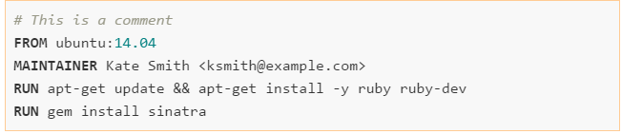
The dockerfile
A Dockerfile is simply a text file that contains a set of steps that can be used to create a Docker image.
Example Dockerfile:

Slide 62
The dockerfile
The FROM instruction specifies the base image to use.
The MAINTAINER instruction specifies who maintains the new image.
A RUN instruction executes a command inside the image, for example installing a package.
Now we can take our Dockerfile and use the docker build command to build an image.

Slide 63
The dockerfile
Use the docker build command to build the image:
$ docker build -t ouruser/sinatra:v2 .
We use the -t flag to identify our new image as belonging to the user ouruser, the repository name sinatra and given it the tag v2.
We specify the current directory as the directory to take the Dockerfile from.
We can also override the default name of the Dockerfile with the –file flag.

Slide 64
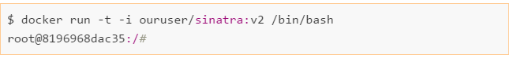
The dockerfile
We can now create a container from our newly created image:

Slide 65
The build context
The docker build command requires a Dockerfile and a build context (which may be empty).
The build context is the set of local files and directories that can be referenced from ADD or COPY instructions in the Dockerfile and is normally specified as a path to a directory.
All the files and directories under the path form the build context and will be sent to the Docker daemon as part of the build process.

Slide 66
The dockerfile
We can actually make things a little bit easier for the user by taking advantage of the ENTRYPOINT Dockerfile instruction.
The ENTRYPOINT instruction lets us specify an executable that is used to handle any arguments passed to docker run.
For example:
ENTRYPOINT[“bin/bash”]
Now we don’t have to specify bash as the argument to docker run.

Slide 67
The dockerfile
The “CMD” command can be used as well to provide defaults to an executing container.
It can also provide parameters to an “ENTRYPOINT” instruction.
ENTRYPOINT overrides any “CMD” settings.

Slide 68
The .dockerignore file
Docker it looks for a file named .dockerignore in the root directory of the context.
If this file exists, it modifies the build context to exclude files and directories that match patterns in it.
This helps to avoid unnecessarily sending large or sensitive files and directories to the daemon and potentially adding them to images using ADD or COPY.
The file should contain the names of files to exclude, separated by newlines. The wildcard characters * and ? are allowed.

Slide 69
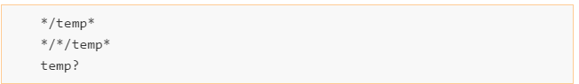
The dockerignore file example

Slide 70
The union filesystem
Union file systems allow multiple file systems to be overlaid, appearing to the user as a single filesystem.
Folders may contain files from multiple filesystems, but if two files have the exact same path, the last mounted file will hide any previous files.
Docker supports several different UFS implentations, including AUFS, Overlay, devicemapper, BTRFS, and ZFS. Which implementation is used is system dependent and can be checked by running docker info

Slide 71
Image layers
Docker images are made up of multiple layers. Each of these layers is a read-only fileystem.
A layer is created for each instruction in a Dockerfile and sits on top of the previous layers.
When an image is turned into a container (from a docker run or docker create command), the Docker engine takes the image and adds a read-write filesystem on top (as well as initializing various settings such as the IP address, name,ID, and resource limits).

Slide 72
Image layers
Each instruction in a Dockerfile results in a new image layer, which can also be used to start a container.
The new layer is created by starting a container using the image of the previous layer, executing the Dockerfile instruction and saving a new image.
Because unnecessary layers bloat images , you will notice that many Dockerfiles try to minimize the number of layers by specifying several UNIX commands in a single RUN instruction.

Slide 73
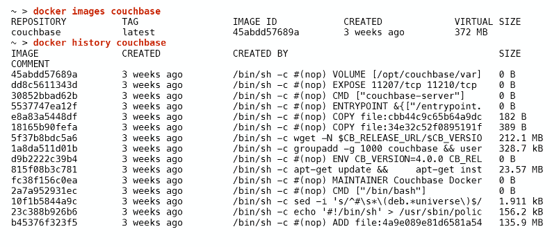
Image layers
Use the docker history command to view image layers:

Slide 74
caching
Docker also caches each layer in order to speed up the building of images.
This caching is very important for efficient workflows, but is somewhat naive.
The cache is used for an instruction if: • The previous instruction was found in the cache and • there is a layer in the cache that has exactly the same instruction and parent layer.
Also, in the case of COPY and ADD instructions, the cache will be invalidated if the checksum or metadata for any of the files has changed.

Slide 75
caching
RUN instructions that are not guaranteed to have the same result across multiple invocations will still be cached. Be particularly aware of this if you download files, run apt-get update, or clone source repositories.
If you need to invalidate the cache, you can run docker build with the --no-cache argument

Slide 76
Base image
When creating your own images, you will need to decide which base image to start from.
The best-case scenario is that you don’t need to create an image at all—you can just use an existing one and mount your configuration files and/or data into it. This is likely to be the case for common application software, such as databases and web servers, where there are official images available.
Sometimes you really just need a small but complete Linux distro - the alpine image, which is only just over 5 MB in size butstill has an extensive packager manager for easily installing applications and tools. Debian is also t good option for an Ubuntu-like small image.

Slide 77
Dockerfile instructions
ADD - Copies files from the build context or remote URLs into the image. If an archive file is added from a local path, it will automatically be unpacked.
CMD - Runs the given instruction when the container is started. If an ENTRYPOINT has been defined, the instruction will be interpreted as an argument to the ENTRYPOINT . The CMD instruction is overridden by any arguments to docker run after the image name. Only the last CMD instruction will have an effect

Slide 78
Dockerfile instructions
COPY - used to copy files from the build context into the image. It has two forms, COPY src dest_ and COPY [" src", " dest"] , both of which copy the file or directory at src in the build context to dest inside the container.
ENTRYPOINT - ets an executable (and default arguments) to be run when the container starts. Any CMD instructions or arguments to docker run after the image name will be passed as parameters to the executable. ENTRYPOINT instructions are often used to provide “starter” scripts that initialize variables and services before interpreting any given arguments.

Slide 79
Dockerfile instructions
ENV- sets environment variables inside the image. These can be referred to in subsequent instructions. For example: ENV MY_VERSION 1.3 RUN apt-get install -y mypackage=$MY_VERSION The variables will also be available inside the image.
EXPOSE- Indicates to Docker that the container will have a process listening on the given port or ports. This information is used by Docker when linking containers.
FROM -Sets the base image for the Dockerfile; subsequent instructions build on top of this image. The base image is specified as IMAGE:TAG (e.g., debian:wheezy). If the tag is omitted, it is assumed to be latest

Slide 80
Dockerfile instructions
MAINTAINER - Sets the “Author” metadata on the image to the given string. You can retrieve this with docker inspect -f {{.Author}} IMAGE.
ONBUILD - Specifies an instruction to be executed later, when the image is used as the base layer to another image.
RUN - Runs the given instruction inside the container and commits the result.
USER - Sets the user (by name or UID) to use in any subsequent RUN, CMD, or ENTRYPOINT instructions.

Slide 81
Dockerfile instructions
VOLUME- Declares the specified file or directory to be a volume. If the file or directory already exists in the image, it will copied into the volume when the container is started. If multiple arguments are given, they are interpreted as multiple volume statements. You cannot specify the host directory for a volume inside a Dockerfile for portability and security reasons.
WORKDIR- Sets the working directory for any subsequent RUN, CMD, ENTRYPOINT, ADD, or COPY instructions. Can be used multiple times. Relative paths may be used and are resolved relative to the previous WORKDIR.

Slide 82
Summary
The Dockerfile
Image layers
Dockerfile instructions.

Slide 83
Questions ?

Slide 84
The docker hub
Publishing images

Slide 85
The docker hub
The Docker Hub is the online registry provided by Docker Inc. The Hub provides free repositories for public images, or users can pay for private repositories.
In order to store our image in the Docker Hub, we need to create a Docker Hub account and push the image to the hub:
$ docker tag identidock:latest amouat/identidock:0.1 $ docker push amouat/identidock:0.1 The push refers to a repository [docker.io/amouat/identidock] (len: 1) 76899e56d187: Image successfully pushed

Slide 86
The docker hub
The first thing we need to do is create an alias for the image in the Docker Hub user namsepace. This means it must be in the form <username>/<repository name> where <username> is your username on the Docker Hub and <repositoryname> is the name you want the repository to have on the Hub. We also take the opportunity to set the tag to 0.1 for this image.
We next pushe the image using the alias we just created. This will create the repository if it doesn’t exist and upload the image under the appropriate tag.
At this point, identidock is publicly available, and anyone can retrieve it by doing a docker pull.

Slide 87
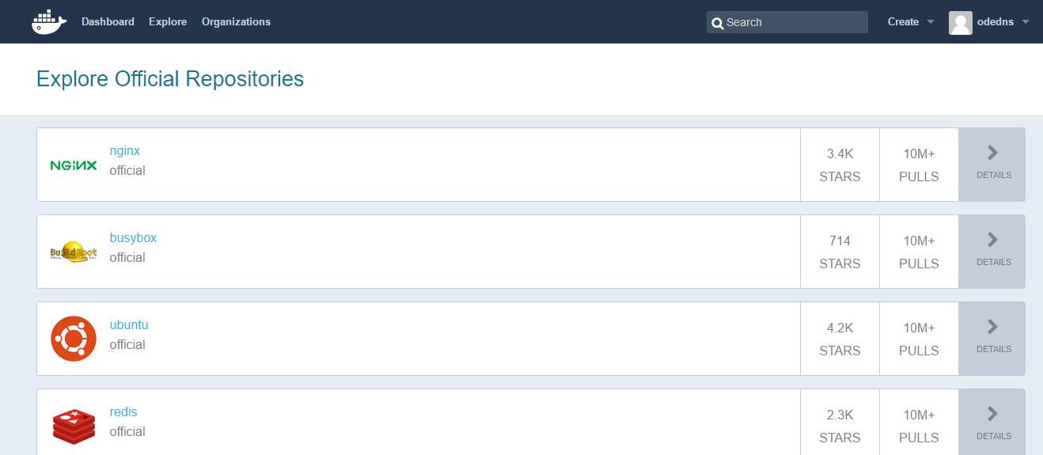
The docker hub

Slide 88
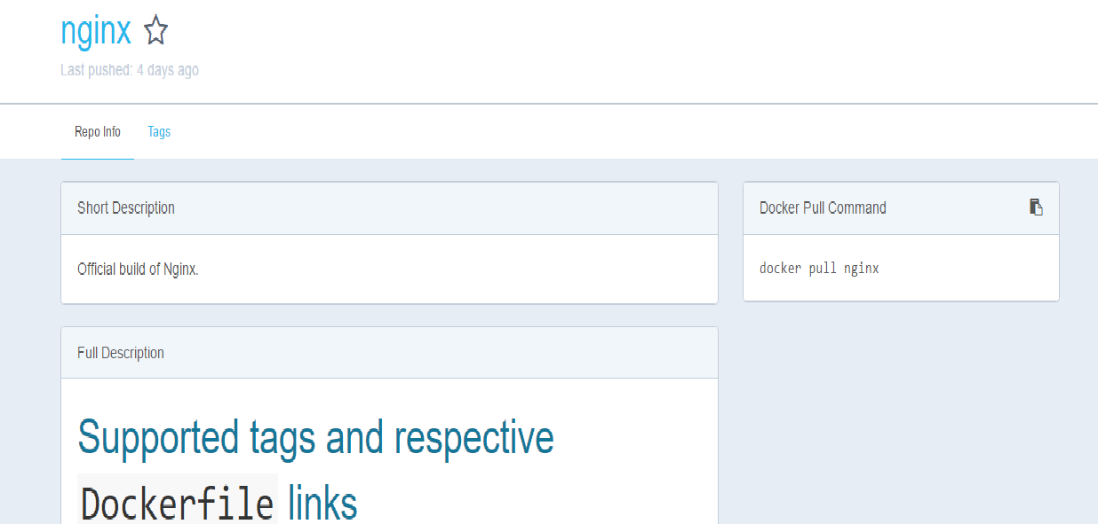
The docker hub

Slide 89
Automated builds
Whenever we want to update the repository, we just repeat the tag and push stepsvusing whichever image we want. If we use an existing tag, the previous image will be overwritten.
But what if we simply want our images to be updated whenever our code is?
This is a very common use case, and for that reason, the Docker Hub introduced the concept of automated builds.

Slide 90
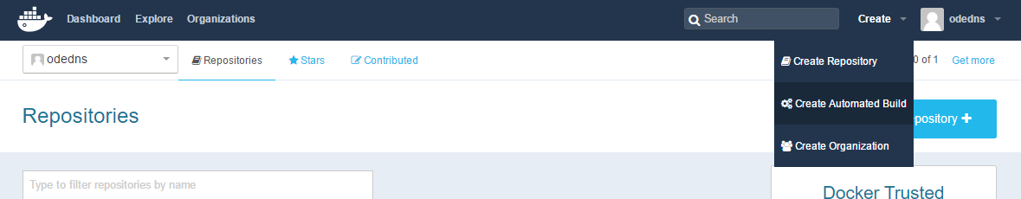
Automated builds

Slide 91
Automated builds
Locate the repository with the image code.
Once you’ve selected the repository, you will be taken to the configuration page for the automated build.
Leave the first “Tag” field as Branch and name as master to track the code from the master branch.
Set “Dockerfile Location”
Click“Create.” Docker will take you to the build page for this new repository. You can kick off the first build by clicking “Trigger a Build.”
We can now test the build automation by making a small change to source code.

Slide 92
Private registry
For open source projects and small side projects, the Hub is perfect. But for anything larger or more serious, you will want to replace or augment it with other solutions.
We can use a different registry, which can be hosted either by yourself or a third party.
Let’s look at the free solution—running your own registry.

Slide 93
Private registry
The easiest way to run a local registry is by using the official image. We can quickly get started by running: $ docker run -d -p 5000:5000 registry:2
Now that we have a running registry, we can tag an image appropriately and push it.
$ docker tag amouat/identidock:0.1 localhost:5000/identidock:0.1 $ docker push localhost:5000/identidock:0.1 The push refers to a repository [localhost:5000/identidock] (len: 1)

Slide 94
Private registry
If we now remove the local version, we can pull it again.
Docker sees that we already have an image with the same content, so all that really happens is the tag is added back. You may have noticed that the registry generated a digest for the image. This is unique hash based on the content on the image and its metadata.
The primary advantage of using a digest is that it guarantees you are pulling exactly the image you think you are. When pulling by tag, the underlying image may change at any time without you knowing.

Slide 95
summary
The Docker Hub
Automated builds
Using a private registry

Slide 96
Questions ?

Slide 97
Docker networking

Slide 98
Docker networking
Docker has four built-in networking modes:
Bridge
Host
Container
None
There are three networks created by docker out of the box:
Bridge
Host
None

Slide 99
Bridge network
There is a Docker bridge, normally called docker0 and running on 172.17.42.1, which is used to connect containers.
When a container is started, Docker will instantiate a veth pair - essentially the software equivalent of an Ethernet cable—connecting eth0 in the container to the bridge.
By default, all containers can talk to each other, regardless of whether or not they are linked or if they export or publish ports.
However containers are not exposed to the world.

Slide 100
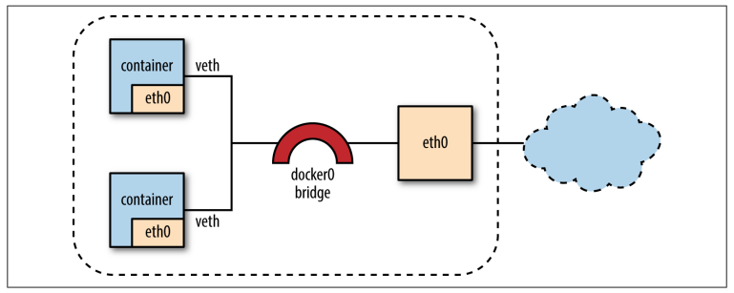
Bridge network

Slide 101
Host network
A container running on the host network shares the networking namespace of the host,fully exposing it to the public network.
This means the container has to share the IP address of the host, but also cuts out all of the plumbing of the bridge network, meaning it is as fast as normal host networking.
However if we have more than one container running on the host there will be conflicts, unless we configure services on different ports.

Slide 102
Container network
Uses the networking namespace from another container. This can be very useful in certain situations.
This allows the creation and easy reuse of efficient network stacks specialized to a given scenario or datacenter architecture.
The disadvantage is that all containers sharing a network stack will need to use the same IP address, etc.

Slide 103
None network
Turns off networking completely for a container.
This can be useful for containers that don’t need any network, such as a compiler container that writes its output to a volume.
The none networking mode can also be useful when you need to set up your own networking from scratch.

Slide 104
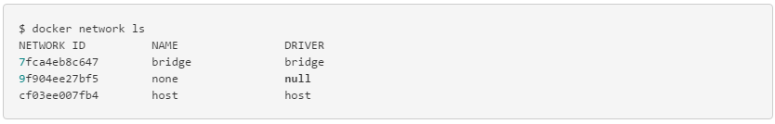
Docker networking
Use the docker network ls command to display the available networks:

Slide 105
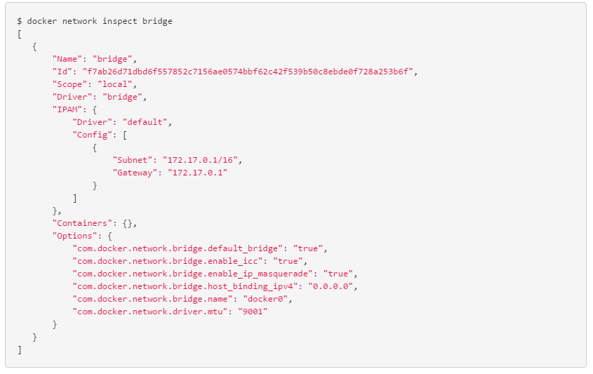
Docker networking
The docker network inspect command displays information about a network:

Slide 106
Docker networking
The bridge network represents the docker0 network present in all Docker installations.
Unless you specify otherwise with the docker run --net=<NETWORK> option, the Docker daemon connects containers to this network by default.

Slide 107
User defined networks
We can create a custom network and assign specific containers to that private network.
To create a custom network we specify the network driver and network name:
$ docker network create --driver bridge isolated_nw
The containers you launch into this network must reside on the same Docker host.
Each container in the network can immediately communicate with other containers in the network.
Though, the network itself isolates the containers from external networks.

Slide 108
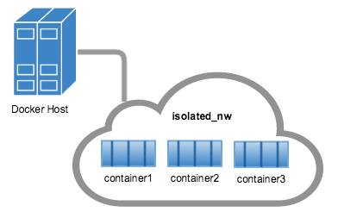
User defined networks

Slide 109
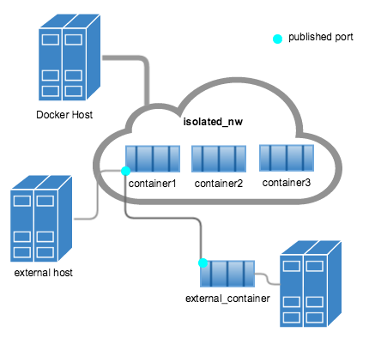
User defined networks

Slide 110
The overlay network
Docker’s overlay network driver supports multi-host networking natively out-of-the-box.
The overlay network requires a valid key-value store service. Currently, Docker’s libkv supports Consul, Etcd, and ZooKeeper
Before creating a network you must install and configure your chosen key-value store service. The Docker hosts that you intend to network and the service must be able to communicate.

Slide 111
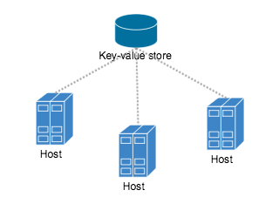
The overlay network

Slide 112
Docker netwoking
Setting up a multi-host network - https://docs.docker.com/engine/userguide/networking/get-started-overlay/
Swarm and container networks - https://docs.docker.com/swarm/networking/

Slide 113
summary
Docker networking
User defined networks
Multi-host networks

Slide 114
Questions ?

Slide 115
Logging and monitoring

Slide 116
logging
It’s simplest to begin by describing what docker provides out of the box. If you don’t specify any arguments or install any logging software, Docker will log everything sent to STDOUT and STDERR.
The logs can then be retrieved with the docker logs command. For example: $ docker run --name logtest debian sh -c 'echo "stdout"; echo "stderr" >>2' $ docker logs logtest
We can also stream the logs from a running container with -f

Slide 117
logging
There are several other logging methods available that can be started by using the --log-driver argument to docker run. The default logger can be changed by passing the --log-driver argument when starting the Docker daemon. The possible values for the logger are:
json-file- The default logging we’ve just looked at.
syslog -The syslog driver.
journald -The driver for the systemd journal.
gelf -The Graylog Extended Log Format (GELF) driver.
fluentd - Forwards log messages to fluentd.
None - Turns off logging

Slide 118
Aggregating logs
No matter which logging driver you use, it will only provide a partial solution, especially in multihost systems.
What we want to do is aggregate all logs—potentially across hosts—into a single location so that we can run analytic and monitoring tools on them.
The preferred solutions would be to collect the logs on the host, or in a separate, standalone container and forward to the aggregation service.
Notes:
Collect the logs on the host, or in a separate, standalone container and forward to the aggregation service.

Slide 119
Aggregating logs
There are several log aggregation tools we can use.
One popular solution is Splunk, a commercial log aggregation tool.
There are several open source alternatives to splunk.

Slide 120
Using ELK
The ELK stack is short for Elasticsearch, Logstash, and Kibana.
Elasticsearch -A text search engine with near real-time search.
Logstash - tool for reading in raw logs, then parsing and filtering them, before sending them onto another service, such as index or store ,in our case, Logstash will forward to Elasticsearch.
Kibana - A JavaScript-based graphical interface to Elasticsearch. It can be used to run Elasticsearch queries and visualize the results in various charts.

Slide 121
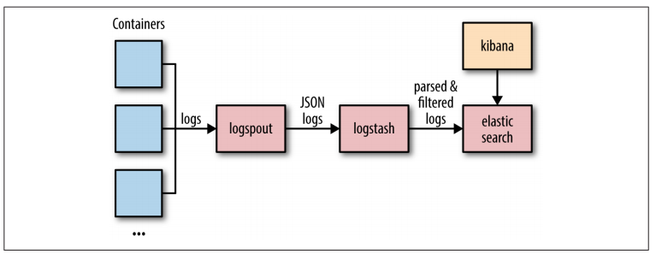
Using elk

Slide 122
Docker events
Events are logged for most of the stages in the lifecycle of a Docker container. These events include create,destroy, die, export, kill, pause, attach, restart, start, stop, and unpause.
We can retrieve events using the docker events command: $ docker events 2015-09-24T15:23:28.000000000+01:00 44fe57bab...: (from debian) create 2015-09-24T15:23:28.000000000+01:00 44fe57bab...: (from debian) attach 2015-09-24T15:23:28.000000000+01:00 44fe57bab...: (from debian) start 2015-09-24T15:23:28.000000000+01:00 44fe57bab...: (from debian) die

Slide 123
monitoring
Docker comes with a basic CLI tool, docker stats, that returns a live stream of resource usage. The command takes the name of one or more containers and prints various statistics for them, in much the same way as the Unix application top. For example:
$ docker stats logging_logspout_1 CONTAINER CPU % MEM USAGE/LIMIT MEM % NET I/O logging_logspout_1 0.13% 1.696 MB/2.099 GB 0.08% 4.06 kB/9.479 kB
Note that unless you have set memory limits on the container, the limit you see on memory will represent the total amount of memory on the host, rather than the amount of memory available to the container.

Slide 124
monitoring
Getting stats from all containers:
$ docker stats \ $(docker inspect -f {{.Name}} $(docker ps -q)) CONTAINER CPU % MEM USAGE/LIMIT ... /logging_dnmonster_1 0.00% 57.51 MB/2.099 GB /logging_elasticsearch_1 0.60% 337.8 MB/2.099 GB /logging_identidock_1 0.01% 29.03 MB/2.099 GB /logging_kibana_1 0.00% 61.61 MB/2.099 GB /logging_logspout_1 0.14% 1.7 MB/2.099 GB /logging_logstash_1 0.57% 263.8 MB/2.099 GB

Slide 125
Using Cadvisor
cAdvisor (a contraction of Container Advisor) from Google is the most commonly used Docker monitoring tool. It provides a graphical overview of the resource usage and performance metrics of containers running on the host.
As cAdvisor is available as a container itself, Just launch the cAdvisor container with the following arguments: $ docker run -d \ --name cadvisor \ -v /:/rootfs:ro \ -v /var/run:/var/run:rw \ -v /sys:/sys:ro \ -v /var/lib/docker/:/var/lib/docker:ro \ -p 8080:8080 \ google/cadvisor:latest

Slide 126
Using cadvisor
Once the container is running, point your browser at http://localhost:8080. You should see a page with a bunch of graphs.
You can drill down to specific containers by clicking the “Docker Containers” link and then clicking the name of the container you’re interested in.
Note: don’t forget to setup virtualbox port forwarding in order to access the url on the docker host.

Slide 127
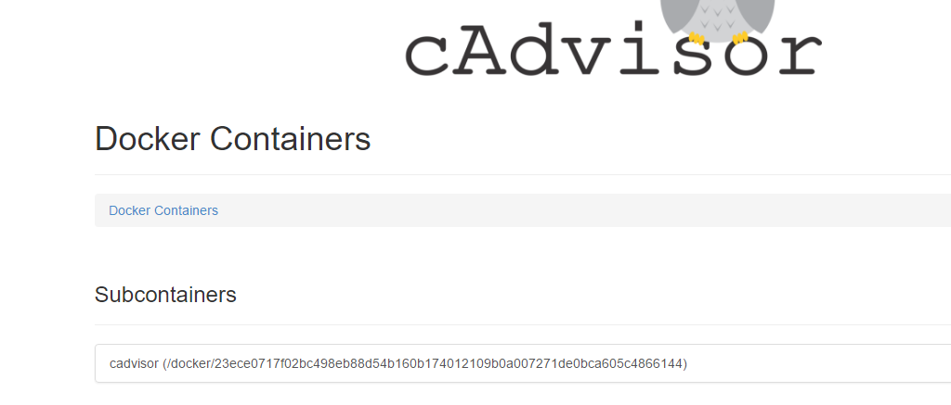
cadvisor

Slide 128
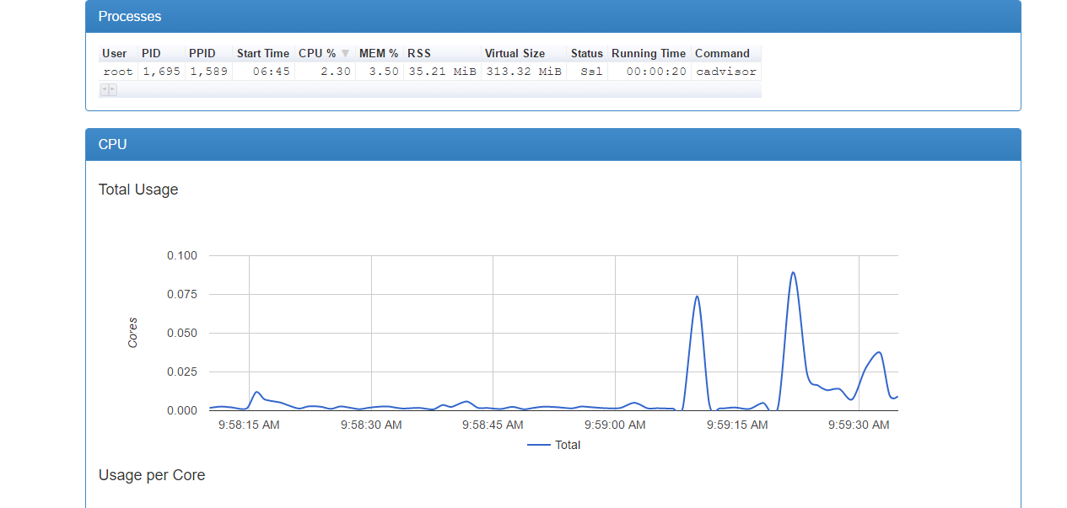
cadvisor

Slide 129
summary
Logging
Aggregating logs
Monitoring
Using cAdvisor

Slide 130
Questions ?

Slide 131
Docker testing
Using Docker with CI

Slide 132
What is continuous integration ?
Continuous integration is a concept that is implemented by a set of practices.
Software is always in a working state and ready to run.
Continuous integration requires that every time somebody commits any change, the entire application is built and a comprehensive set of automated tests is run against it.
If the change breaks the software, we know it immediately and can fix it.

Slide 133
Continuous Integration requirments
Version control
Automated build
Agreement

Slide 134
Continuous Integration Practices
Check in regularly
Create automated tests
Have a short build process

Slide 135
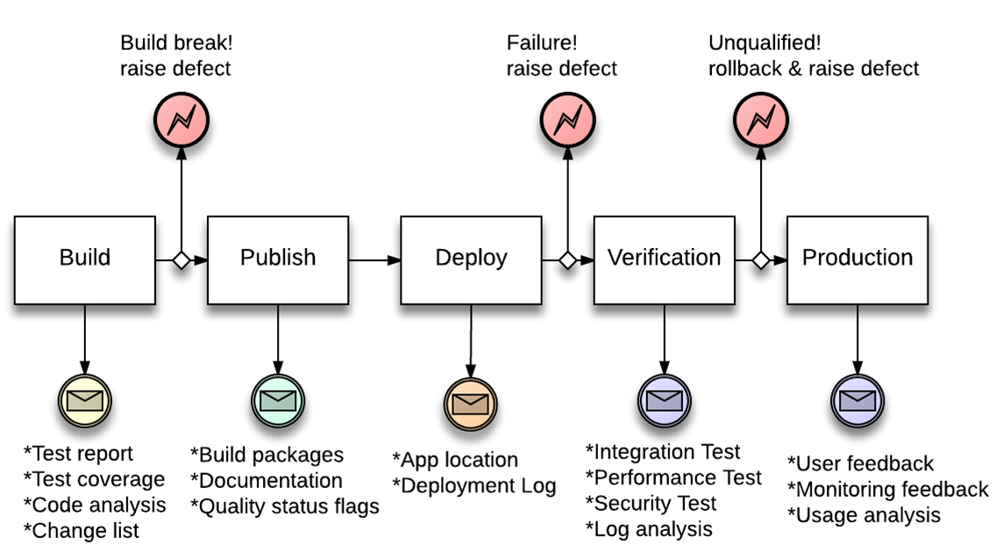
CI pipeline

Slide 136
How does docker fit ?
CI pipelines include a deploy stage where a VM is created and automatic deployment of the build artifact is executed.
This is usually performed using Devops tools such as Chef,Ansible etc.
Docker makes this step much easier, by running a container with the build artifact so that it will be available for automations steps.

Slide 137
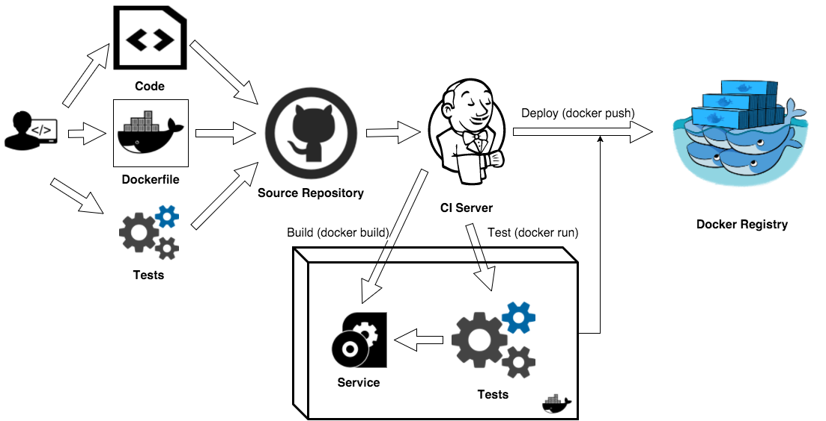

Slide 138
CI Deployment with docker
One approach would be to build a docker image with the build artifact as part of the build and run that container.
Another approach would be to run an existing container image and deploy the build artifact using devops tools (Chef,Ansible,Puppet)
If the container passes automations tests, we might store it to the registry so that it can be deployed by QA or even customers eventually.

Slide 139
Questions ?

Slide 140
Docker deployment

Slide 141
deployment
The fastest and simplest way to provision new resources and run containers on them is via Docker Machine. Machine can create servers, install Docker on them, and configure the local Docker client to access them.
Machine comes with drivers for most of the major cloud providers (including AWS, Google Compute Engine, Microsoft Azure, and Digital Ocean) as well as VMWare and VirtualBox.

Slide 142
deployment
Create a docker machine on digitalocean:
$ docker-machine create --driver digitalocean \ --digitalocean-access-token 4820... \ identihost-do Creating SSH key... Creating Digital Ocean droplet...
The next thing to do is to point our local client at it, using the command given in the output: $ docker-machine env identihost-do
Now all docker commands will run on this machine.

Slide 143
Docker compose
Compose is a tool for defining and running multi-container Docker applications.
With Compose, you use a Compose file to configure your application’s services.
Then, using a single command, you create and start all the services from your configuration.

Slide 144
Docker compose
To use docker compose:
Define your app’s environment with a Dockerfile so it can be reproduced anywhere.
Define the services that make up your app in docker-compose.yml so they can be run together in an isolated environment.
Lastly, run docker-compose up and Compose will start and run your entire app.

Slide 145
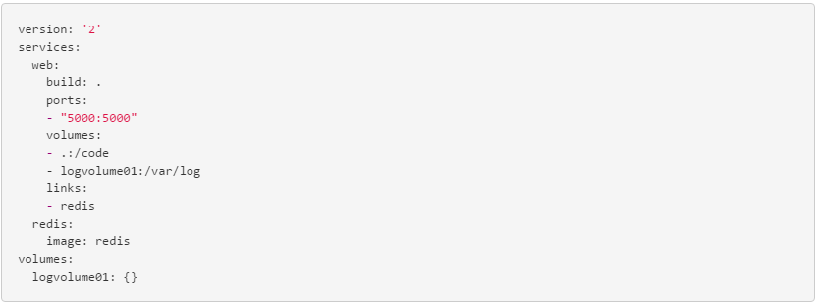
Docker compose example

Slide 146
Using devops tools
If your organization is responsible for more than a handful of hosts, chances are that you’re using some sort of configuration management (CM) tool.
All projects need to consider how they are going to ensure the operating system on the Docker host is up to date, especially with regard to security patches. In turn, you also want to make sure the Docker images you are running are up to date.
Devops CM solutions such as Puppet, Chef, Ansible, and Salt are designed to help manage these issues.

Slide 147
Using devops tools
There are two main ways we can use CM tools with containers:
We can treat our containers as VMs and use CM software to manage and update the software inside them.
We can use the CM software to manage the Docker host and ensure containers are running the correct version of images, but view the containers themselves as black boxes that can be replaced, but not modified.

Slide 148
clustering
In practice we will need to distribute the containers between VMs.
In a large production environment, doing this manually is impractical.
We need a clustering management solution in order to handle this.
There are several clustering solutions for Docker.
We will take a look at the native docker solution: Swarm.

Slide 149
swarm
Swarm is the native clustering tool for Docker.
Swarm uses the standard Docker API, containers can be launched using normal docker run commands and Swarm will take care of selecting an appropriate host to run the container on.
This also means that other tools that use the Docker API—such as Compose and bespoke script can use Swarm without any changes and take advantage of running on a cluster rather than a single host.

Slide 150
swarm
The basic architecture of Swarm is fairly straightforward: each host runs a Swarm agent and one host runs a Swarm manager
The manager is responsible for the orchestration and scheduling of containers on the hosts.
There are several different methods for how hosts are found and added to a cluster, which is known as discovery in Swarm.
By default, token-based discovery is used, where the addresses of hosts are kept in a list stored on the Docker Hub.

Slide 151
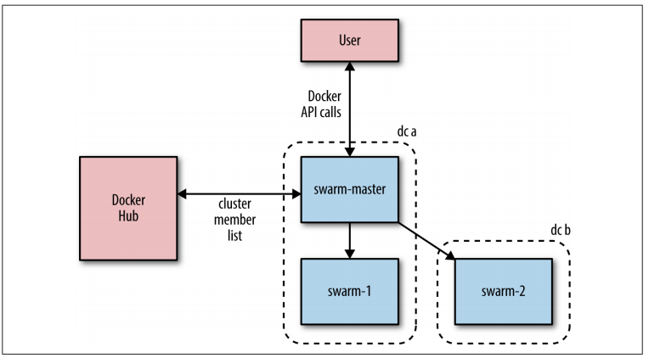
Swarm

Slide 152
summary
Deployment
Docker-machine
Docker-compose
Clustering - Swarm

Slide 153
Questions ?

Slide 154
summary
What did we discuss ?
What did we learn ?
Feedback

Slide 155
Thank You

